Slide 1

Cryptography
CS-486
November 20th, 2017 r00 Paul A. Lambert

Slide 2
Cryptography Monday November 20th, 2017
ECIES
Projects
Key Exchanges:
Email security:
homepages.gold.ac.uk/rachel/CIS326week9.ppt
www.cse.scu.edu/~tschwarz/COEN350_09/PPtPre/EmailSecurity.ppt

Slide 3
ECIES
Use public/private key pairs to encrypt information to public key(s). Use ECIES to encrypt the information. For example, Figure 2 in: A Survey of the Elliptic Curve Integrated Encryption Scheme
Elliptic curve routines are available: https://github.com/CryptoUSF/Wallet/tree/master/src/ecc
AEAD encryption algorithms are available on Github:
AES-SIV https://github.com/CryptoUSF/Wallet/tree/master/src/cipher
ChaCha_Poly_AEAD https://github.com/CryptoUSF/Wallet/blob/master/src/cipher/chacha_poly.py
Document your choices for each algorithm block (e.g. KDF). The ECIES routines should be structured as a reusable library. The user interaction may be through a command-line interface. The software should be in a github repository with a readme.md file providing a brief description.
Bonus points awarded for:
documentation of requirements or use case
good documentation
fully 'packaged' software
well written code
designs with good human usability

Slide 4
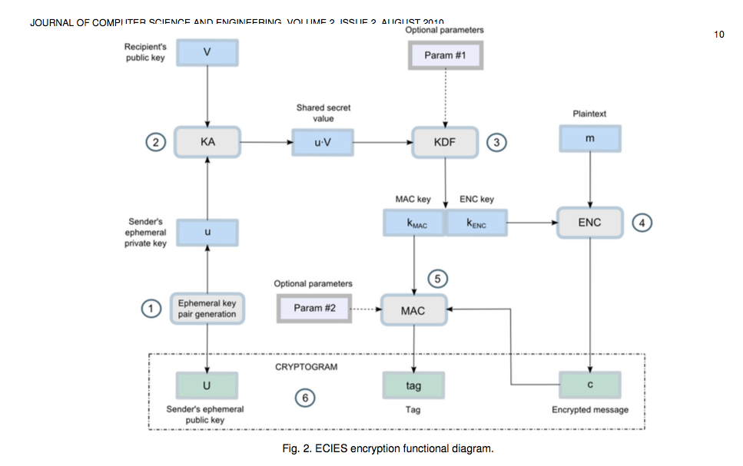
ECIES
https://www.researchgate.net/publication/255970113_A_Survey_of_the_Elliptic_Curve_Integrated_Encryption_Scheme

Slide 5
ECIES
AEAD
https://www.researchgate.net/publication/255970113_A_Survey_of_the_Elliptic_Curve_Integrated_Encryption_Scheme

Slide 6
ECIES with an AEAD
V (Peer Public Key)
Additional Data
Plain Text / Data
ad
pt
AEAD
(e.g. ChaCha_AEAD)
key=KDF(u*V)
key
u = new private key
U = u*G
IV/nonce
U
IV
Cipher Text
Tag

Slide 7
ECIES with SIV
V (Peer Public Key)
Additional Data
Plain Text / Data
pt
ad
SIV AEAD
(e.g. AES-SIV
key=KDF(u*V)
key
u = new private key
U = u*G
U
SIV
Cipher Text

Slide 8
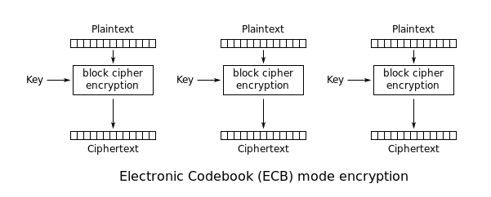
ECB Mode
https://en.wikipedia.org/wiki/Block_cipher_mode_of_operation

Slide 9
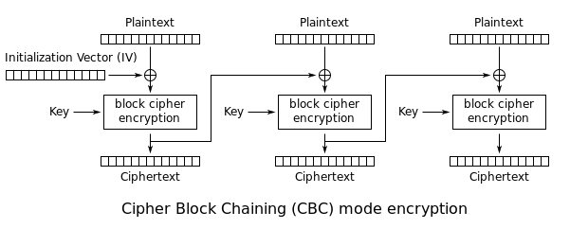
CBC Mode
https://en.wikipedia.org/wiki/Block_cipher_mode_of_operation

Slide 10
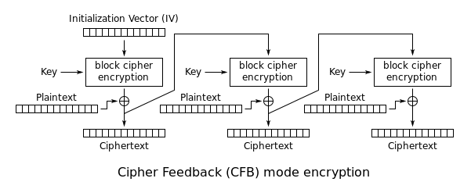
CFB Mode
https://en.wikipedia.org/wiki/Block_cipher_mode_of_operation

Slide 11
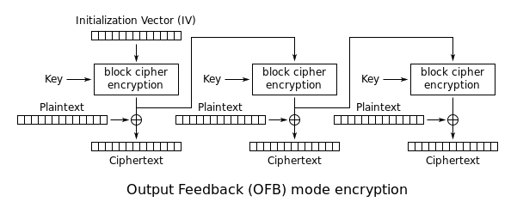
OFB Mode
https://en.wikipedia.org/wiki/Block_cipher_mode_of_operation

Slide 12
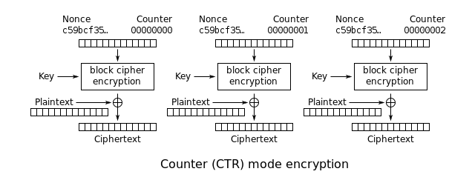
CTR Mode
https://en.wikipedia.org/wiki/Block_cipher_mode_of_operation

Slide 13
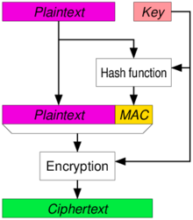
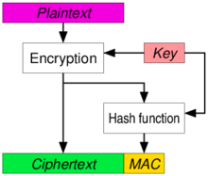
Authenticated Encryption
https://en.wikipedia.org/wiki/Authenticated_encryption

Slide 14
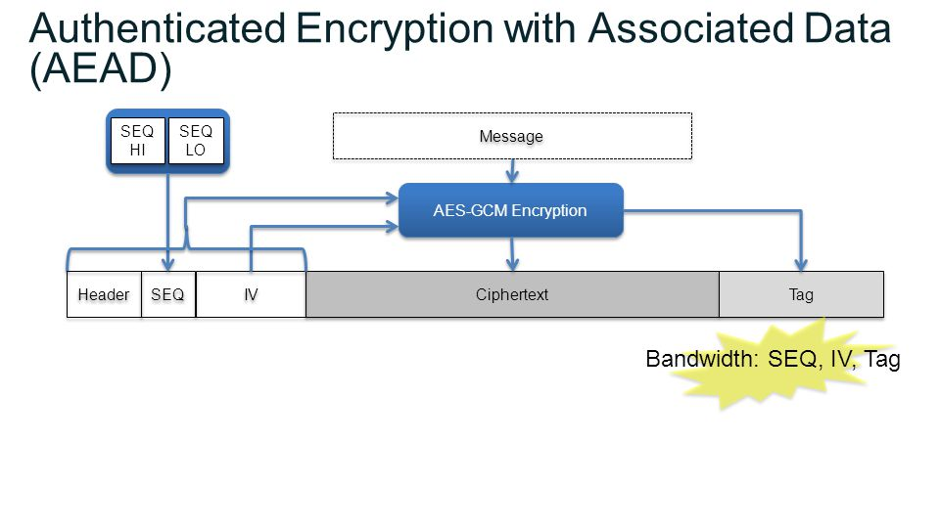
AES-GCM (an AEAD)

Slide 15
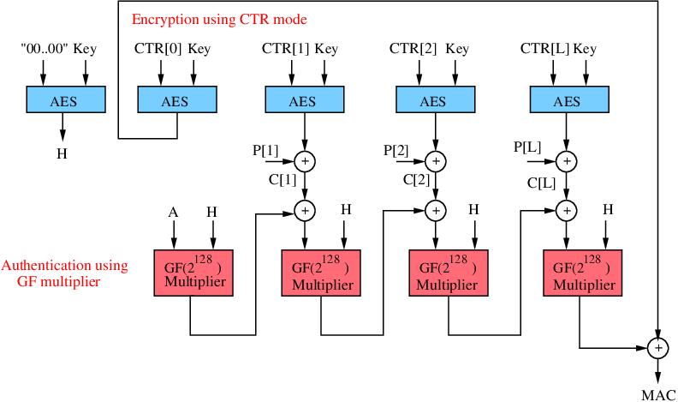
AES-GCM (an AEAD)

Slide 16
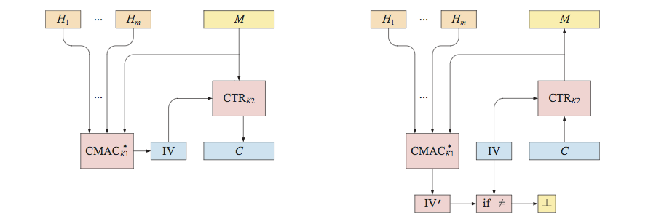
SIV Mode
http://web.cs.ucdavis.edu/~rogaway/papers/siv.pdf
https://tools.ietf.org/html/rfc5297

Slide 17
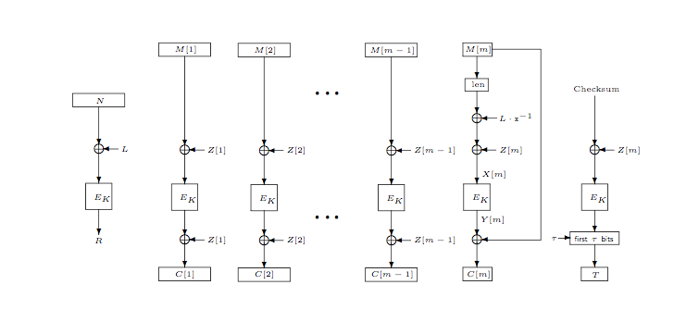
OCB
http://web.cs.ucdavis.edu/~rogaway/papers/ocb-full.pdf

Slide 18
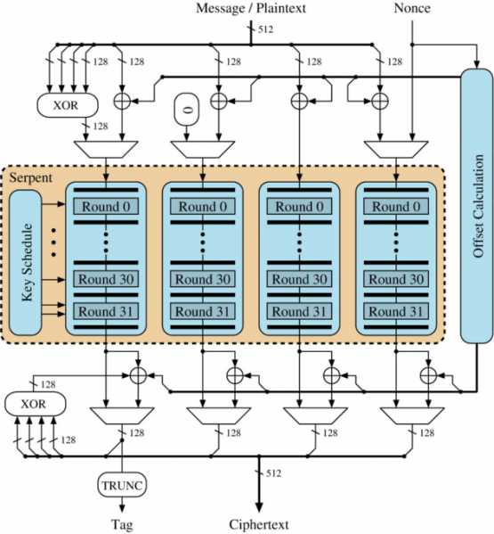
OCB Again

Slide 19
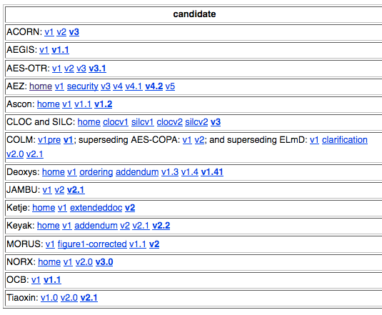
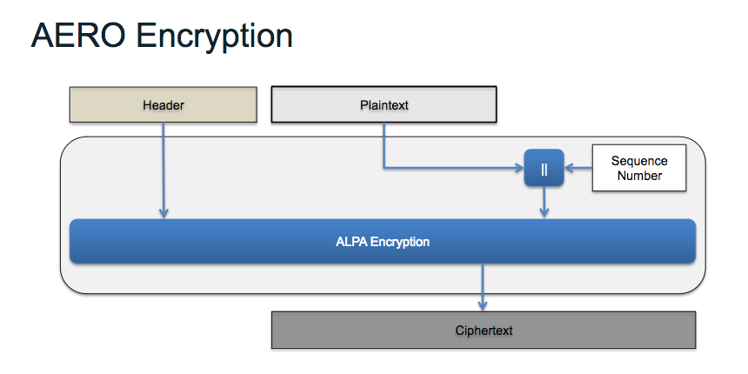
Other AEAD Algorithms
Caesar competition (2018): https://competitions.cr.yp.to/caesar-submissions.html
https://csrc.nist.gov/csrc/media/events/lightweight-cryptography-workshop-2015/documents/presentations/session8-mcgrew.pdf

Slide 20
Email, PEM, PGP
www.cse.scu.edu/~tschwarz/COEN350_09/PPtPre/EmailSecurity.ppt

Slide 21
Cryptographic Notation
s | private key used to generate the public key
G | generator element of the group used for public key operations
+ | associative group operation (point addition for ECC)
* | scalar multiplication is the repeated addition of a group element with itself
P | a long-term public key where P=s*G
H() | hash function
len(S) | denotes the length of a string in bytes, represented as an eight-byte big-endian number.
sk | symmetric secret key developed from DH key agreement
|| | denotes concatenation of strings
{ }sk | curly braces indicate AEAD encryption by the key appended to the second brace (e.g. ‘sk’). The protocol shall fail and terminate when the integrity check on decryption fails.
P_{A} P_{B} | Subscripts indicate the entity that controls the key pair (Alice ‘A’ , Bob ‘B’)
Alice
s_{A}
P_{A} = s_{A}*G
Bob
s_{B}
P_{B} = s_{B}*G

Slide 22
SPAKE2
_{i}id_{A} = “Alice”
id_{B} = “Bob”
shared secret pw
id_{B} = “Bob”
id_{A} = “Alice”
Alice
Bob
w = H( pw )
x_{A} = randRange(0,p*h)
X_{A} = x_{A}*G
R_{A} = w*M_{A} + X_{A}
M_{A} and M_{B} are known group elements selected for their security properties.
R_{A}
w = H( pw )
x_{B} = randRange(0,p*h)
X_{B} = x_{B}*G
R_{B} = w*M_{B} + X_{B}
R_{B}
K = x_{A} * (R_{B} – w*M_{B})
sk = H(len(idA)|| idA || len(idB) || idB || len(RA) || RA || len(RB) || RB || len(w) || w || len(K) || K)
K = x_{B} * (R_{A} – w*M_{A})
sk = H(len(idA)|| idA || len(idB) || idB || len(RA) || RA || len(RB) || RB || len(w) || w || len(K) || K)
After the exchange the properties are:
- Alice and Bob share a pair-wise unique symmetric key ‘sk’ with certainty that their peer knew the shared secret ‘pw’ If the peer did not use the same passphrase ‘pw’ the shared secret (sk) will not be the same for the peers.
- Note that this 2-step exchange does not include validation of the shared secret key
https://tools.ietf.org/html/draft-irtf-cfrg-spake2-03 http://www.di.ens.fr/~mabdalla/papers/AbPo05a-letter.pdf

Slide 23
Blinded Diffie-Hellman (bDH) //www.emvco.com/specifications.aspx?id=285
The EMVco defined bDH protocol is asymmetric and only authenticates one side of the exchange.
s_{A} P_{A} = s_{A}*G
Bob
Alice
y_{A} = randRange(0,p*h)
Y_{A} = y_{A}* P_{A}
Y_{A}
x_{B} = randRange(0,p*h)
X_{B} = x_{B}*G
K = x_{B}*Y_{A}
sk_{BA} = H( “R” || K )
encrypt( key=sk_{BA}, ( ...) )
K = s_{A}*y_{A}*X_{B}
sk_{BA} = H( “R” || K )
decrypt( key=sk_{BA}, { ... } )
sk_{AB} = H( “I” || K )
encrypt( key=sk_{AB}, ((y_{A}, P_{A}), ...) )
X_{B}, { ... }sk_{BA}
{ (y_{A}, P_{A}), ... }sk_{AB}
sk_{AB} = H( “I” || K )
decrypt( key=sk_{AB}, { (y_{A}, P_{A}), ... } )
assert Y_{A} == y_{A}*P_{A}
encrypt( key=sk_{AB}, (...) )
{ ... }sk_{BA}
decrypt( key=sk_{BA}, { ... } )
After the exchange the properties are: - Alice and Bob share pair-wise unique symmetric keys
- Alice has not received a long-term public key from Bob
- Bob has Alice’s public key P_{A} and has validated its ownership to the peer with shared key ‘sk_{AB}’

Slide 24
Making bDH Mutual
Additions to bDH to make the protocol symmetric and provide mutual authentication are shown in red
s_{A} P_{A} = s_{A}*G
Bob
s_{B}
P_{B} = s_{B}*G
Alice
y_{A} = randRange(0,p*h)
Y_{A} = y_{A}* P_{A}
Y_{A}
y_{B} = randRange(0,p*h)
Y_{B} = x_{B}*G y_{B}*P_{B}
K = s_{B}*y_{B}*Y_{A}
sk_{BA} = H( “R” || K )
encrypt( key=sk_{BA}, ((y_{B}, P_{B}), ...) )
K = s_{A}*y_{A}*Y_{B}
sk_{BA} = H( “R” || K )
decrypt( key=sk_{BA}, { (y_{B}, P_{B}), ... } )
assert Y_{B} == y_{B}*P_{B}
sk_{AB} = H( “I” || K )
encrypt( key=sk_{AB}, ((y_{A}, P_{A}), ...) )
Y_{B}, { (y_{B}, P_{B}), ... }sk_{BA}
{ (y_{A}, P_{A}), ... }sk_{AB}
sk_{AB} = H( “I” || K )
decrypt( key=sk_{AB}, { (y_{A}, P_{A}), ... } )
assert R_{A} == y_{A}*P_{A}
encrypt( key=sk_{AB}, (...) )
{ ... }sk_{BA}
decrypt( key=sk_{BA}, { ... } )
After the exchange the properties are: - Alice and Bob share pair-wise unique symmetric keys with certainty that their peer knew the shared secret ‘pw’
- Alice has Bob’s public key P_{B} and has validated its ownership to the peer with shared key ‘sk_{BA}’
- Bob has Alice’s public key P_{A} and has validated its ownership to the peer with shared key ‘sk_{AB}’

Slide 25
Mutually Blinded DH (mbDH) https://www.emvco.com/specifications.aspx?id=285
s_{A} P_{A} = s_{A}*G
Bob
s_{B}
P_{B} = s_{B}*G
Alice
y_{A} = randRange(0,p*h)
Y_{A} = y_{A}* P_{A}
Y_{A}
y_{B} = randRange(0,p*h)
Y_{B} = y_{B}*P_{B}
K = s_{B}*y_{B}*Y_{A}
sk_{BA} = H( “R” || K )
encrypt( key=sk_{BA}, ((y_{B}, P_{B}), ...) )
K = s_{A}*y_{A}*Y_{B}
sk_{BA} = H( “R” || K )
decrypt( key=sk_{BA}, { (y_{B}, P_{B}), ... } )
assert Y_{B} == y_{B}*P_{B}
sk_{AB} = H( “I” || K )
encrypt( key=sk_{AB}, ((y_{A}, P_{A}), ...) )
Y_{B}, { (y_{B}, P_{B}), ... }sk_{BA}
{ (y_{A}, P_{A}), ... }sk_{AB}
sk_{AB} = H( “I” || K )
decrypt( key=sk_{AB}, { (y_{A}, P_{A}), ... } )
assert R_{A} == y_{A}*P_{A}
encrypt( key=sk_{AB}, (...) )
{ ... }sk_{BA}
decrypt( key=sk_{BA}, { ... } )
After the exchange the properties are: - Alice and Bob share pair-wise unique symmetric keys with certainty that their peer knew the shared secret ‘pw’
- Alice has Bob’s public key P_{B} and has validated its ownership to the peer with shared key ‘sk_{BA}’
- Bob has Alice’s public key P_{A} and has validated its ownership to the peer with shared key ‘sk_{AB}’

Slide 26
Backup Material

Slide 27
Logistics for Class
Canvas CS-486-01
Primary repository for grading
URL for all homework submittals must be ‘linked’ into the appropriate Canvas assignment!
Github: https://github.com/CryptoUSF
Course material, class presentations, references, books
Sample code for assignments: https://github.com/CryptoUSF
Private student repositories,
too many if one per assignment per student
Wiki for additional class information and assignements
Piazza: CS486
Informal class conversations

Slide 28
Additional References
Courses:
https://crypto.stanford.edu/~dabo/courses/OnlineCrypto/
http://cseweb.ucsd.edu/~mihir/cse207/
Conferences:
Real World Cryptography
https://www.iacr.org
Mailing Lists and Standards:
http://csrc.nist.gov US Federal security specifications
https://trac.ietf.org/trac/sec/wiki Internet security standards
https://irtf.org/cfrg Internet cryptographic research

Slide 29
References
Books:
Handbook of Applied Cryptography
http://web.cs.ucdavis.edu/~rogaway/classes/227/spring05/book/main.pdf
Violent Python - A Cookbook for Hackers, Forensic Analysts, Penetration Testers and Security Engineers
Poc||GTFO
…
More books: https://iacr.org/books/

Slide 30
Raspberry Pi
We will use a Raspberry Pi to get experience using contemporary analysis ‘tools’
Raspberry Pi
Excellent reference for what to acquire and how to setup:http://rpi.cs.usfca.edu/2017-fall
The first Pi project will use cryptographic related tools that are available in the Kali distribution: https://www.kali.org/
The tools do not necessarily require the Kali OS distribution and you may be able to simply install some of the tools on an existing Raspberry Pi OS installation.

